Slide 1
¹⁵N Solid-State NMR Study for the Development of a Membrane Protein Drug-Screening Methodology
Anna K. Wright, Ivan Hung, D.D. Busath, A. Kolocouris, Timothy A. Cross
Experimental Nuclear Conference, April 2013

Slide 2
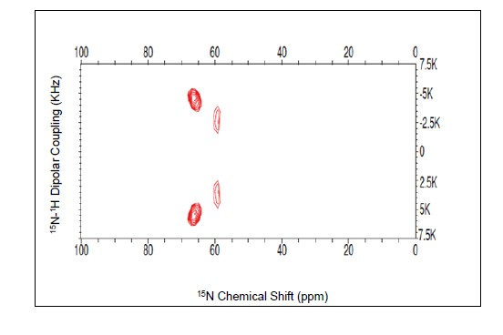
PISEMA WT M2 TMD in AAO
15N-Ile33,42 M2-TMD in aligned DMPC bilayers deposited onto AAO filters
Two spots, two residues
Potential for flow system

Slide 3
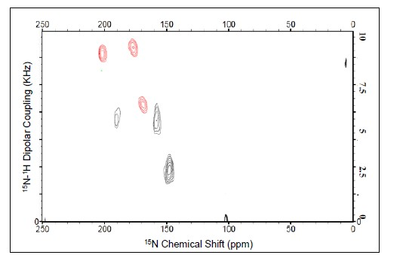
PISEMA S31N M2 TMD on Glass
Superimposed PISEMA spectra of 15N- Val28,Ala30,Ile42 S31N M2-TMD in aligned DMPC bilayers on glass slides, with (red) and without (black) drug present
Strong impacts near and far

Slide 4
Set 2, Viral Inhibition Assays
Structure-Activity Relationship (SAR) Series
Brent Johnson
H1N1 virus in MDCK culture
Anti-influenza antibodies to count miniplaques
Here are the results of the screens. All drugs run at 50 uM.
Drug Miniplaques
AK10 14, 20
AK37 8, 11
AK38 5,6
AK39 19, 18
AK40 15, 13
Controls 78, 109, 88, 84
Looks like all of them are active

